Slide 1


Lecture 07
Irfan Malik
Dr. Sheraz Naseer

Slide 2
Agenda
What is Programming?
Basic Concepts of Programming
What is variable?
Rules for naming variables
Data types
Colab Notebook hands on
Quiz

Slide 3
Previous lecture:
Lecture 06 - Diffusion Models
Click Here

Slide 4
What is programming?

Slide 5
Definition of Programming
Programming is the process of creating sets of instructions that tell a computer what to do.
It involves writing code in a programming language to solve problems or automate tasks.

Slide 6
Key Elements of Programming
Instructions: Creating step-by-step instructions to guide the computer's actions.
Language: Using a programming language to communicate with the computer.
Problem Solving: Analyzing problems and designing solutions using logical thinking.

Slide 7
Programming Languages
Definition: Programming languages are formal languages designed to communicate instructions to a computer.
Examples: Python, Java, C++, Kotlin

Slide 8
Basic Programming Concepts

Slide 9
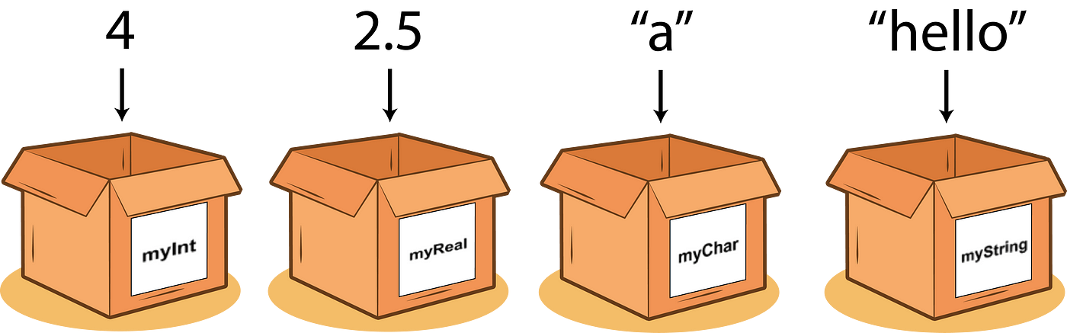
What are Variables?
Definition: Variables are containers that hold data values in a program.
Analogy: Think of variables as labeled boxes used to store different types of items

Slide 10
Variable Naming
Rules:
Start with a letter or underscore (_).
Can include letters, numbers, and underscores.
Avoid using reserved words (e.g., print, if, while).
Analogy: Give your boxes unique and descriptive labels for easy identification.

Slide 11
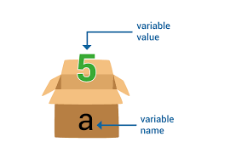
Assigning Values to Variables
Syntax:
variable_name = value
Analogy: Put an item inside a labeled box.
Example: a = 5 (correct)
a == 5 (Wrong)

Slide 12
Data Types of Variables
Integer: whole numbers (e.g., 10, -5)
Float: decimal numbers (e.g., 3.14, -2.5)
String: text (e.g., "Hello", 'Python')
Char: Characters (e.g., “a”)
Analogy: Different types of items can be stored in different boxes.

Slide 13
Next Lecture:
Lecture 08 - String Manipulation (Note Book)
Click Here

